Slide 1
INFO 5717 Group 4 – Term Project
Online Forums and Communities on Data Sciences
By
SAISPHURTHI THUMMALA
ALEKHYA LINGALA
LAKSHMI DEEPA SUNKARA
SAISHIVANI BODDIREDDY

Slide 2
Objectives
Objectives of this system is to create a web system where users can search and insert records into the existing database without any intervention from database. The system will capture and search nearly all the Forums and Online Communities. This system will help the users to understand by giving information about data sciences are their related topics through different Forums and Online Communities and also the users can get to know the opinion and perspective of other users.

Slide 3
User’s Requirements
Our system will web crawl some of the online forums and communities and capture their URLs on data sciences and their related topics. The user requirements are that each should at least capture 10 distinct records for the subject respectively. The other user requirements are to design a system with which we can search information in the data base and external users can add records into database and also can view some of the database results.

Slide 4
Entities
TYPE Table:
The it will mention the specific name of each forum and online communities. Finally, the TYPE table mainly gives the information about Forums and Online Communities. It will describe each and individual Forum and Online Communities on Information System and also respected URL of each forum and online communities were mentioned in the table.
USE_DETAILS Table:
This table gives the information about some of the users who participate in the forum activities or in online Communities on Information Systems. This table contains information about each user like their name, email addresses and their replies in the online communities or in forums. Here each user is given a unique Id in order to identify them as an individual in the database.

Slide 5
Entities
USE_POSTS Table
This table gives information about the posts made by the users on forums or on online communities. The information can be like no.of.likes, no.of.comments, total views and the date of the post. Here for each post a unique ID is given to identify them.
ADMIN Table
This table mainly gives information about login details like Username and Password of the authorized users. These authorized users are the users who have signed up for our website.

Slide 6
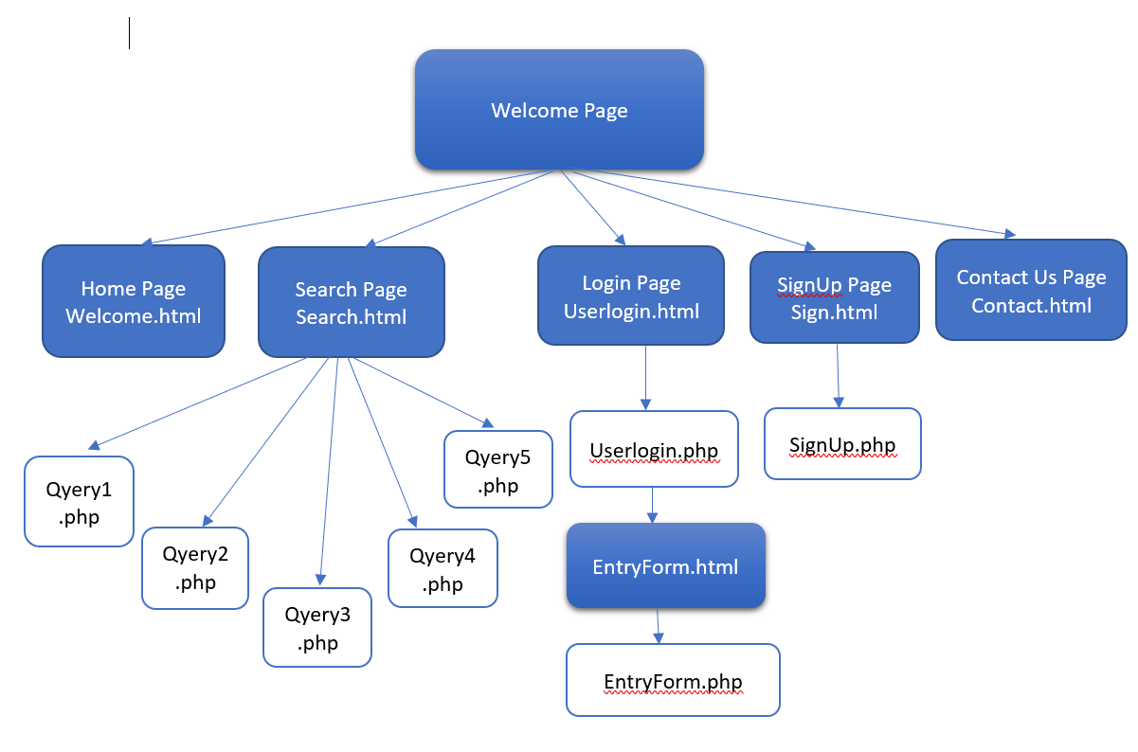
Site Map

Slide 7
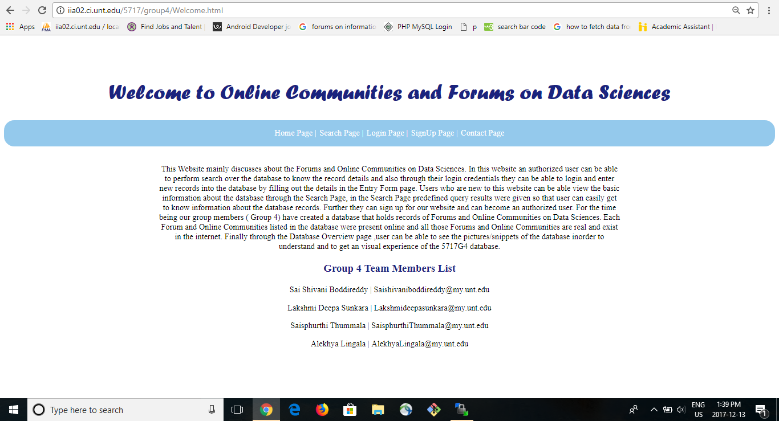
Website
http://iia02.ci.unt.edu/5717/group4/Welcome.html

Slide 8
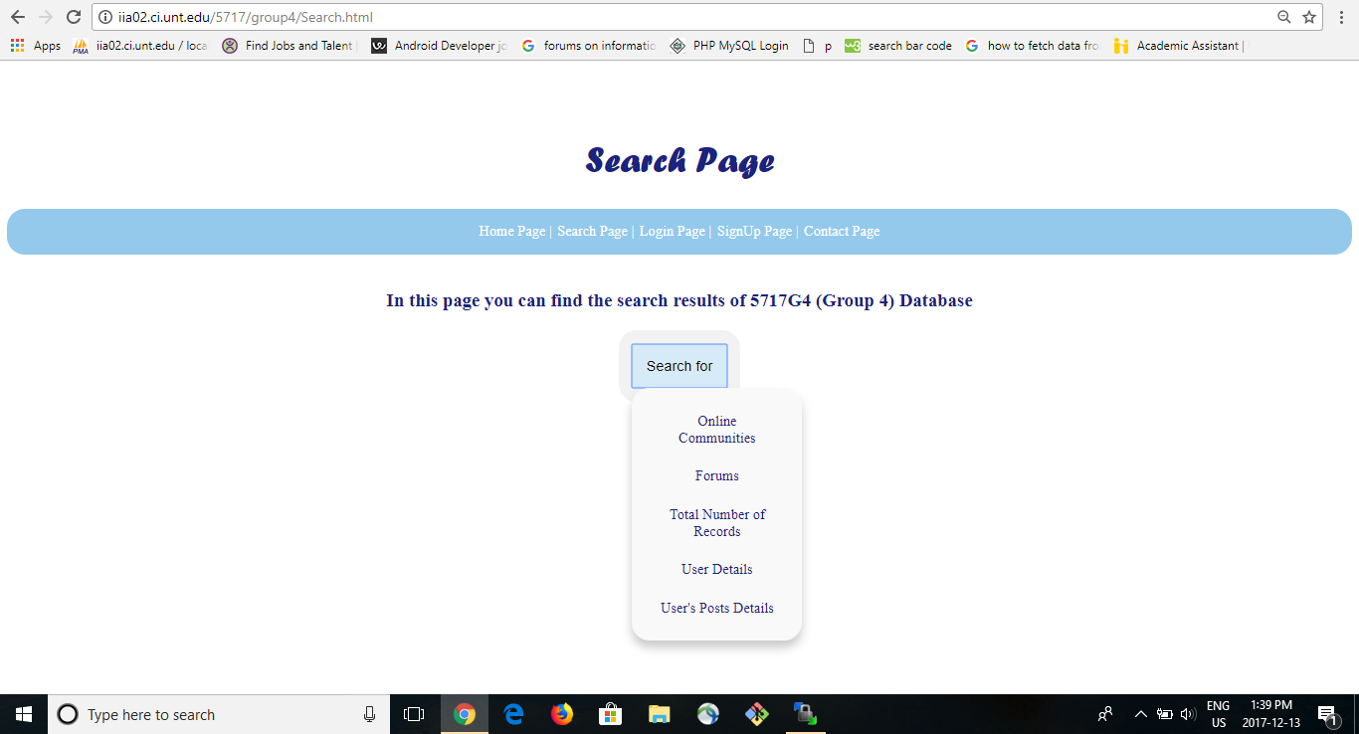
Search Page

Slide 9
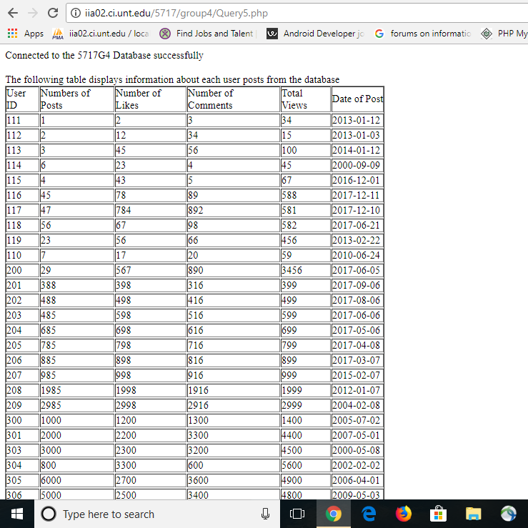
Search Page Results

Slide 10
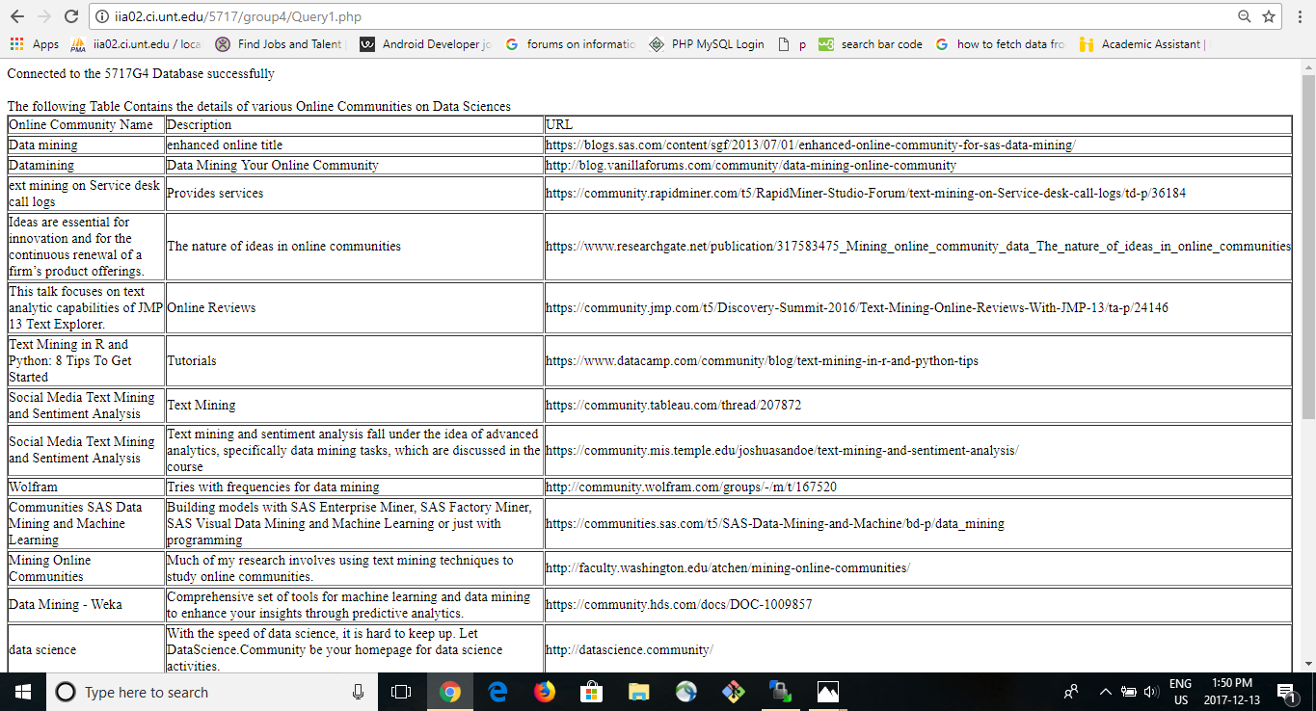
Search Page Results

Slide 11
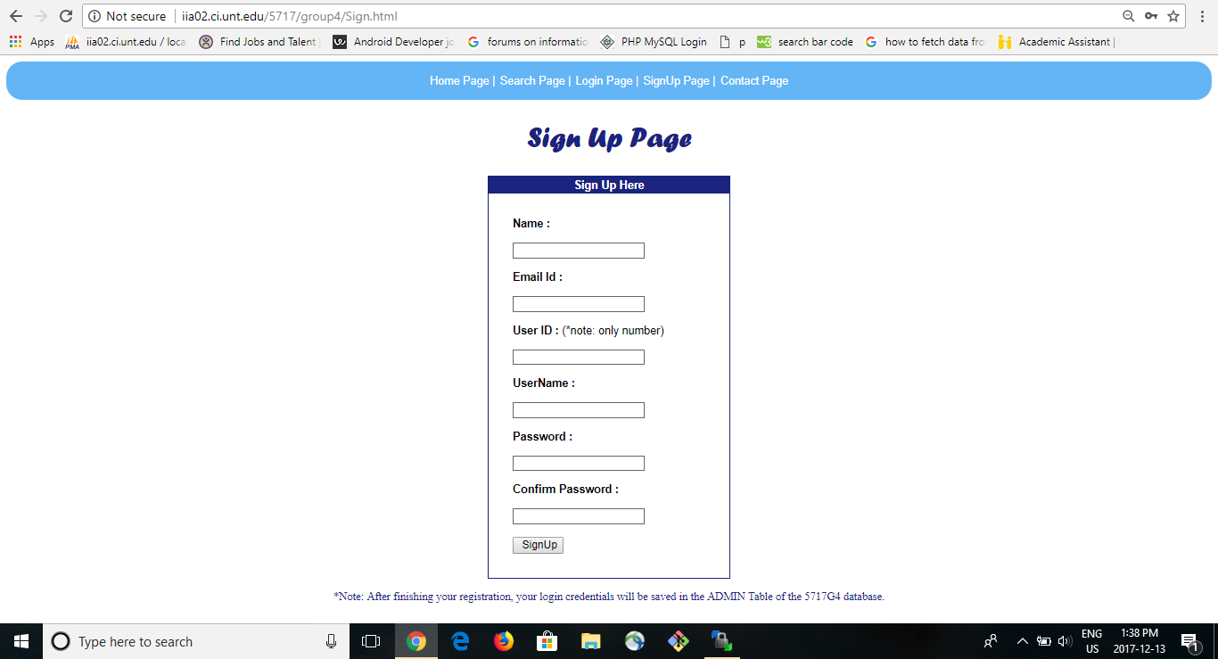
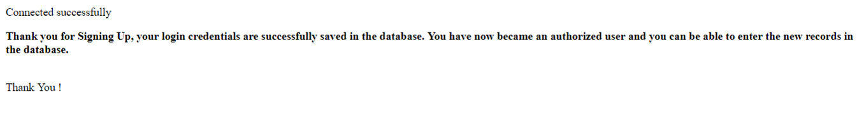
SignUp Page

Slide 12
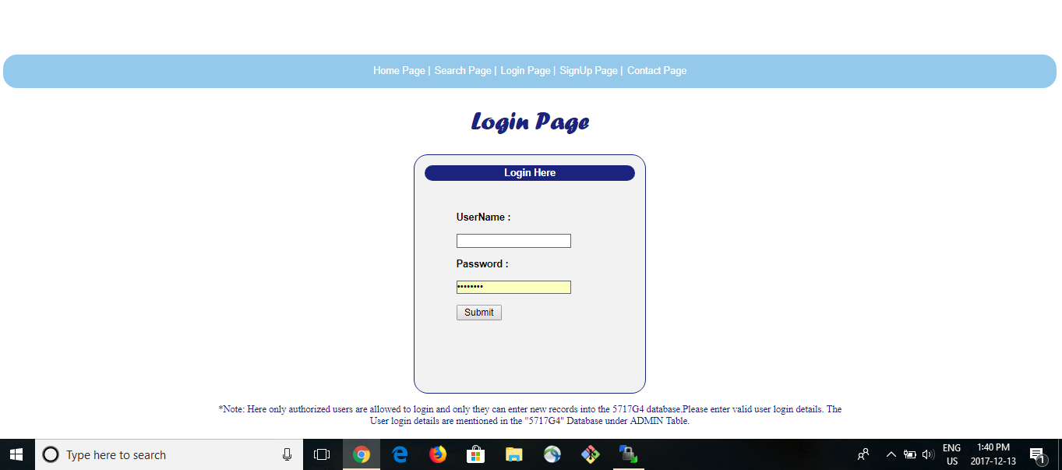
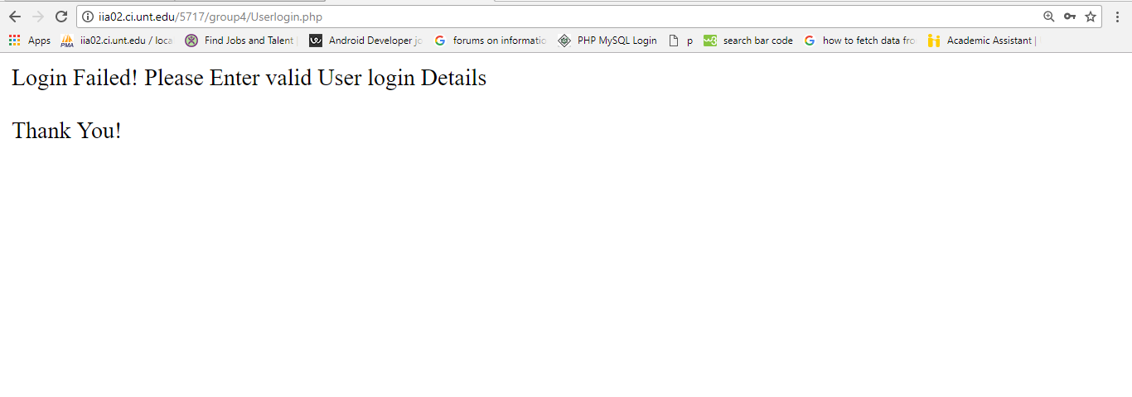
Login Page

Slide 13
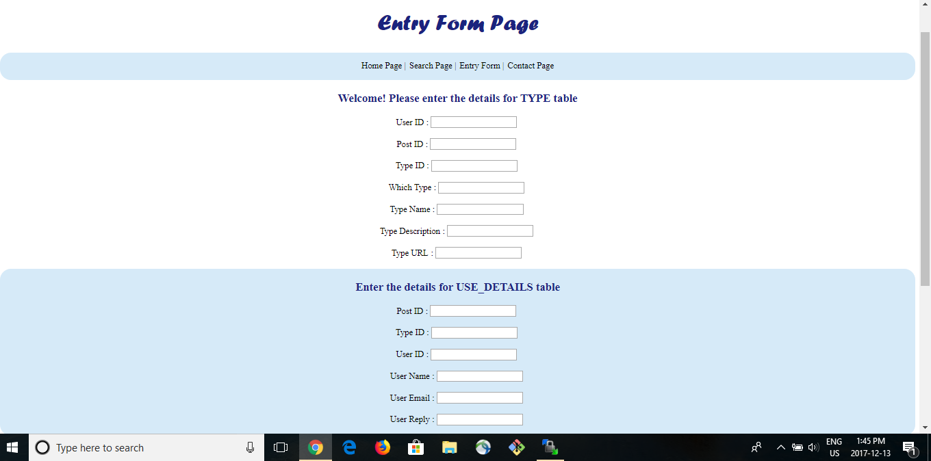
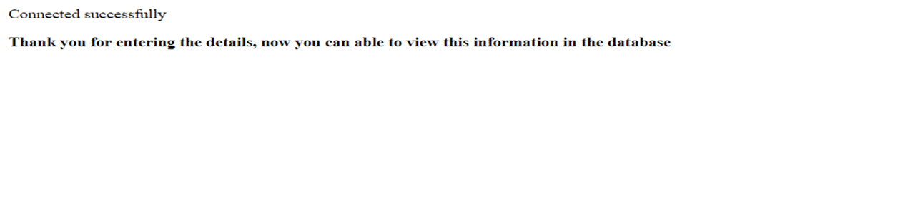
EntryForm Page

Slide 14
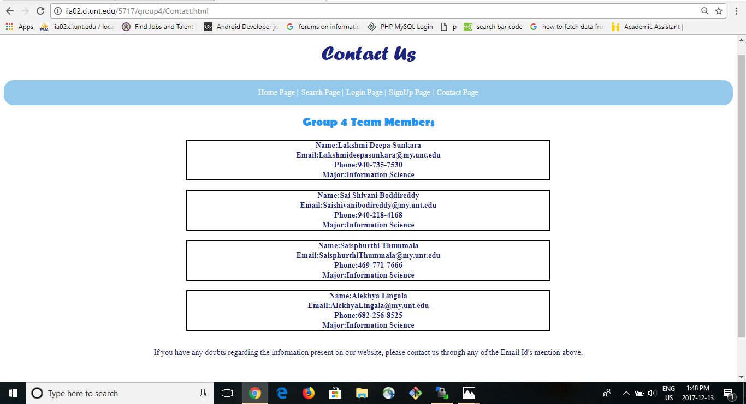
Contact Page

Slide 15
Login Credentials
The following are the some of the Username and Password to access some functions of our system.
1)Username: 5717User1
Password: UserAccess1
2)Username: 5717User2
Password: UserAccess2
3)Username: 5717User3
Password: UserAccess3
4)Username: 5717User4
Password: UserAccess4
5)Username: 5717User5
Password: UserAccess5

Slide 16
Thank You !

